Slide 1
Basic Data Structures
Data Structures and Algorithms
Nanjing University, Fall 2024
郑朝栋

Slide 2
What is a “data structure”?
A data structure is a way to store and organize data in order to facilitate access and modifications.
E.g., array and linked list.
Different types of data demand different data structures.
One type of data could be represented by different data structures. Picking an appropriate one is important!
Computer
<1, 9, 1, 3>
integer sorting algorithm A
<1, 1, 3, 9>
1
9
1
3
Computer
<1, 9, 1, 3>
integer sorting algorithm B
<1, 1, 3, 9>
1
9
1
3

Slide 3
Abstract Data Type (ADT)
A data structure usually provides an interface.
Often, the interface is also called an abstract data type (ADT).
An ADT specifies what a data structure “can do” and “should do”, but not “how to do” them.
ADT: List, which supports get, set, add, remove, … Data structure: ArrayList, LinkedList, …
An ADT is a logical description, and a data structure is a concrete implementation.
Similar to .h file and .cpp file.
Different data structures can implement same ADT. (Why bother?)

Slide 4
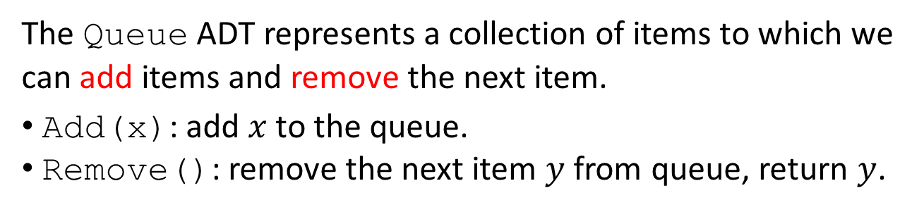
The Queue ADT
The Queue ADT represents a collection of items to which we can add items and remove the next item.
Add(x): add $x$ to the queue.
Remove(): remove the next item $y$ from queue, return $y$.
The queuing discipline decides which item to be removed.

Slide 5

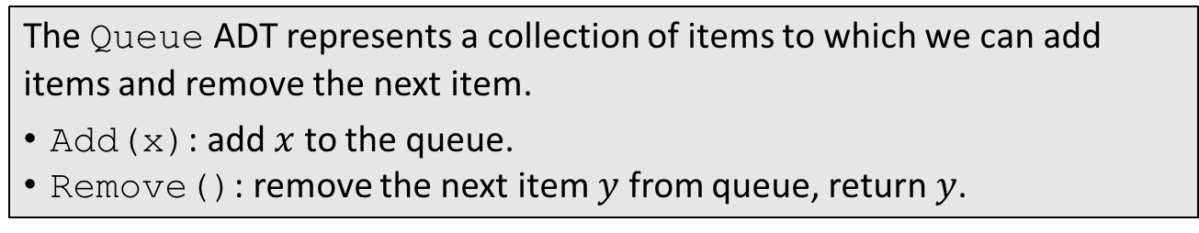
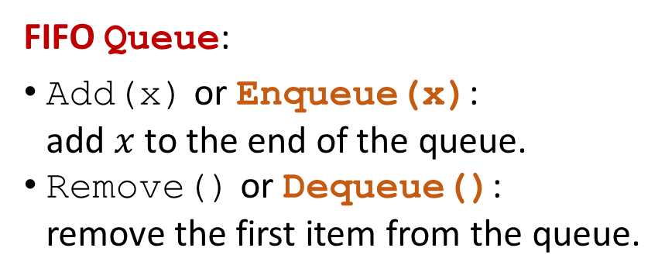
FIFO Queue
The Queue ADT represents a collection of items to which we can add items and remove the next item.
Add(x): add $x$ to the queue.
Remove(): remove the next item $y$ from queue, return $y$.
The first-in-first-out (FIFO) queuing discipline: items are removed in the same order they are added.
Enqueue(x)
FIFO Queue:
Add(x) or Enqueue(x): add $x$ to the end of the queue.
Remove() or Dequeue(): remove the first item from the queue.
Dequeue()

Slide 6
Enqueue(a)
a
Enqueue(b)
a
b
Dequeue()
a
b
Enqueue(f)
b
f

Slide 7
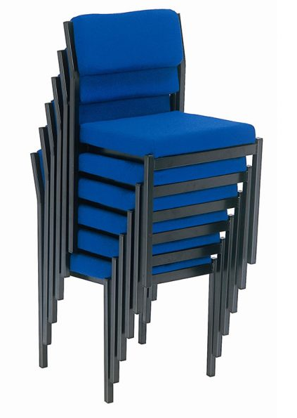
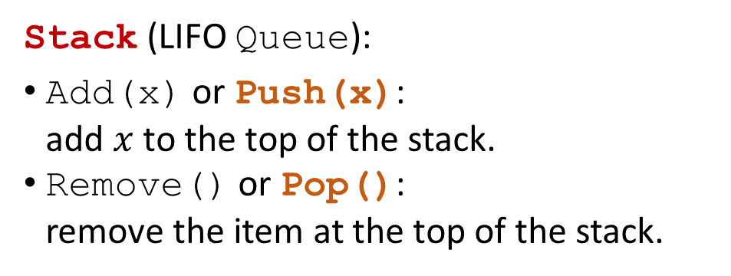
LIFO Queue: Stack
The Queue ADT represents a collection of items to which we can add items and remove the next item.
Add(x): add $x$ to the queue.
Remove(): remove the next item $y$ from queue, return $y$.
The last-in-first-out (LIFO) queuing discipline: the most recently added item is the next one removed.
Pop()
Push(x)
Stack (LIFO Queue):
Add(x) or Push(x): add $x$ to the top of the stack.
Remove() or Pop(): remove the item at the top of the stack.

Slide 8
c
e
a
Pop()
c
e
a
Push(b)
c
e
b
Push(k)
c
e
b
k
Pop()
c
e
b
k

Slide 9
The Deque ADT
The Deque (double-ended queue) ADT represents a sequence of items with a front and a back.
AddFirst(x), AddLast(x), RemoveFirst(), RemoveLast().
AddFirst(x)
AddLast(x)
a
c
b
d
k
…
e
RemoveFirst()
RemoveLast()
Deque can implement FIFO Queue:
Enqueue(x) is AddLast(x), Dequeue() is RemoveFirst().
Deque can implement Stack (LIFO Queue):
Push(x) is AddLast(x), Pop() is RemoveLast().

Slide 10

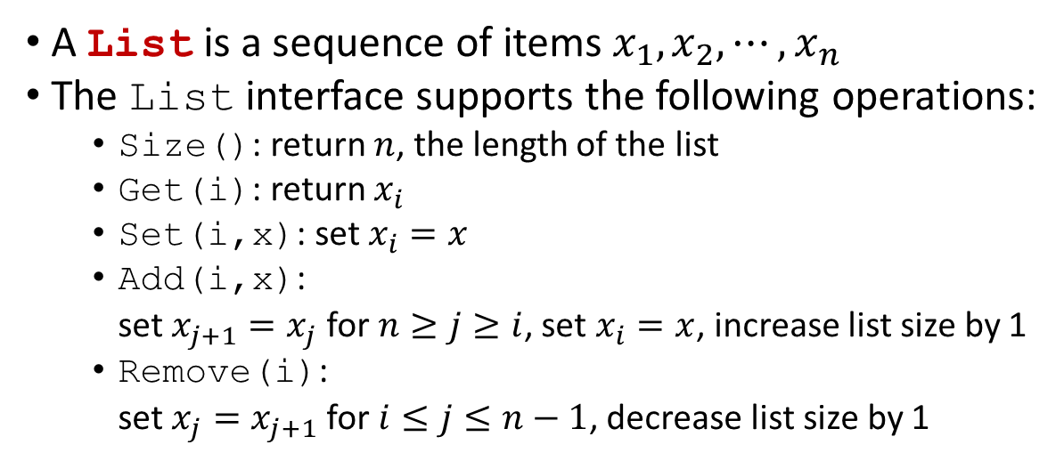
The List ADT
1
2
3
4
5
…
$$n$$
a
c
b
d
k
…
e
A List is a sequence of items $x_{1},x_{2},⋯,x_{n}$
The List interface supports the following operations:
Size(): return $n$, the length of the list
Get(i): return $x_{i}$
Set(i,x): set $x_{i}=x$
Add(i,x): set $x_{j+1}=x_{j}$ for $n≥j≥i$, set $x_{i}=x$, increase list size by 1
Remove(i): set $x_{j}=x_{j+1}$ for $i≤j≤n−1$, decrease list size by 1

Slide 11
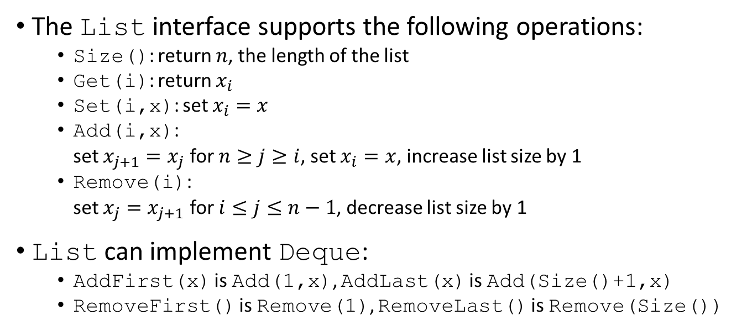
The List ADT
1
2
3
4
5
…
$$n$$
a
c
b
d
k
…
e
The List interface supports the following operations:
Size(): return $n$, the length of the list
Get(i): return $x_{i}$
Set(i,x): set $x_{i}=x$
Add(i,x): set $x_{j+1}=x_{j}$ for $n≥j≥i$, set $x_{i}=x$, increase list size by 1
Remove(i): set $x_{j}=x_{j+1}$ for $i≤j≤n−1$, decrease list size by 1
List can implement Deque:
AddFirst(x) is Add(1,x), AddLast(x) is Add(Size()+1,x)
RemoveFirst() is Remove(1), RemoveLast() is Remove(Size())

Slide 12


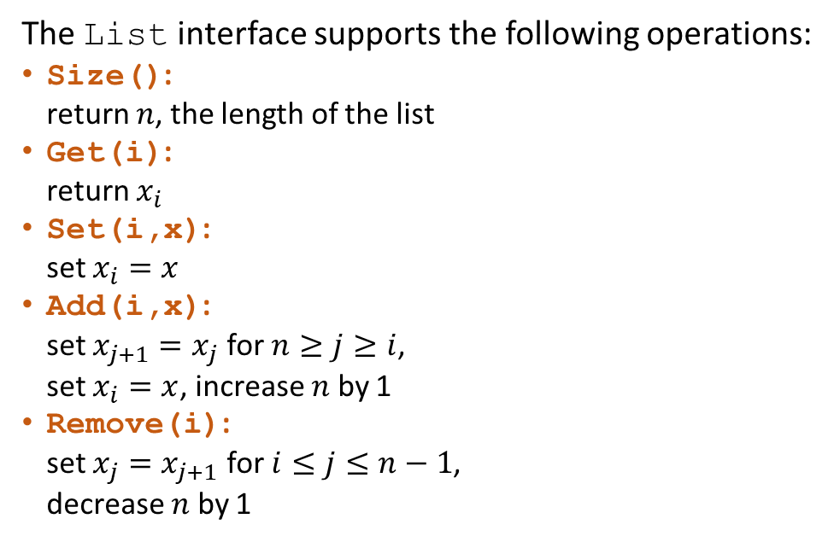



Using array to implement List: ArrayList data structure
The List interface supports the following operations:
Size(): return $n$, the length of the list
Get(i): return $x_{i}$
Set(i,x): set $x_{i}=x$
Add(i,x): set $x_{j+1}=x_{j}$ for $n≥j≥i$, set $x_{i}=x$, increase $n$ by 1
Remove(i): set $x_{j}=x_{j+1}$ for $i≤j≤n−1$, decrease $n$ by 1
always $Θ(1)$
1
2
3
4
5
6
7
8
always $Θ(1)$
c
f
a
c
c
c
c
c
Add(4,d)
always $Θ(1)$
c
f
a
d
c
c
c
c
$Θ(1)$ to $Θ(n)$
Set(3,q)
c
f
q
d
c
c
c
c
Add(1,a)
$Θ(1)$ to $Θ(n)$
a
c
f
q
d
c
c
c
Remove(3)
a
c
q
d
c
c
c
c
Queries and updates are fast.
Modifications are fast at “end”, but slow at “front” or “middle”.

Slide 13
Using array to implement List: ArrayList data structure
The List interface supports the following operations:
Size(): return $n$, the length of the list
Get(i): return $x_{i}$
Set(i,x): set $x_{i}=x$
Add(i,x): set $x_{j+1}=x_{j}$ for $n≥j≥i$, set $x_{i}=x$, increase $n$ by 1
Remove(i): set $x_{j}=x_{j+1}$ for $i≤j≤n−1$, decrease $n$ by 1
always $Θ(1)$
Q: Is ArrayList good for Stack?
A: Yes. (Push and Pop are fast.)
always $Θ(1)$
always $Θ(1)$
Q: Is ArrayList good for FIFO Queue?
A: No. (Dequeue can be slow.)
$Θ(1)$ to $Θ(n)$
Q: Is ArrayList good for Deque?
A: No.
$Θ(1)$ to $Θ(n)$
Queries and updates are fast.
Modifications are fast at “end”, but slow at “front” or “middle”.

Slide 14
Using circular array to implement Deque: ArrayDeque data structure
Using simple array to implement List:
Queries and updates are fast.
Modifications are fast at “end”, but slow at “front” or “middle”.
ArrayList is good for Stack, but not FIFO Queue or Deque.
1
2
3
4
5
6
7
8
1
2
3
4
5
6
7
8
c
f
a
e
q
c
c
c
c
f
a
e
q
c
c
c
head
tail
head
tail
4
5
tail
RemoveFirst()
e
q
1
2
3
4
5
6
7
8
3
a
6
f
a
e
q
c
c
c
c
head
2
f
7
head
tail
1
8

Slide 15

Using circular array to implement Deque: ArrayDeque data structure
Maintain head and tail:
AddFirst and RemoveFirst: move head.
AddLast and RemoveLast: move tail.
Use modular arithmetic to “wrap around” at both ends.
1
2
3
4
5
6
7
8
c
f
a
e
q
c
c
c
head
tail
AddLast(x):
tail=(tail%N)+1
A[tail]=x
RemoveFirst():
head=(head%N)+1
AddFirst(x):
head=(head==1)?N:(head-1)
A[head]=x
RemoveLast(x):
tail=(tail==1)?N:(tail-1)
all in $O(1)$
4
5
tail
e
q
3
a
6
head
2
f
7
1
8

Slide 16
Using circular array to implement Deque: ArrayDeque data structure
Maintain head and tail:
AddFirst and RemoveFirst: move head.
AddLast and RemoveLast: move tail.
Use modular arithmetic to “wrap around” at both ends.
1
2
3
4
5
6
7
8
c
f
a
e
q
c
c
c
head
tail
Queries and updates are fast.
Modifications are fast at “front” and “end” (i.e., head and tail), but still slow at “middle”.
ArrayDeque is good for Stack, FIFO Queue, and Deque; but can be slow for some List operations.
Capacity of array is also a problem!!!
4
5
tail
e
q
3
a
6
head
2
f
7
1
8

Slide 17


Using linked list to implement List: LinkedList data structure
The List interface supports the following operations:
Size(): return $n$, the length of the list
Get(i): return $x_{i}$
Set(i,x): set $x_{i}=x$
Add(i,x): set $x_{j+1}=x_{j}$ for $n≥j≥i$, set $x_{i}=x$, increase $n$ by 1
Remove(i): set $x_{j}=x_{j+1}$ for $i≤j≤n−1$, decrease $n$ by 1
always $Θ(1)$
head
tail
$Θ(1)$ to $Θ(n)$
a
c
d
f
k
$Θ(1)$ to $Θ(n)$
$Θ(1)$ to $Θ(n)$
Q: Is LinkedList good for Stack?
A: Yes. (Push and Pop at head are fast.)
$Θ(1)$ to $Θ(n)$
Q: Is LinkedList good for FIFO Queue?
A: Yes. (Enqueue and Dequeue are fast.)
Traversing backwards from tail is not efficient.
Q: Is LinkedList good for Deque?
A: No. (RemoveLast can be slow.)

Slide 18
Using doubly-linked list to implement List: DLinkedList data structure
The List interface supports the following operations:
Size(): return $n$, the length of the list
Get(i): return $x_{i}$
Set(i,x): set $x_{i}=x$
Add(i,x): set $x_{j+1}=x_{j}$ for $n≥j≥i$, set $x_{i}=x$, increase $n$ by 1
Remove(i): set $x_{j}=x_{j+1}$ for $i≤j≤n−1$, decrease $n$ by 1
always $Θ(1)$
head
tail
$Θ(1)$ to $Θ(n)$
a
c
d
f
k
$Θ(1)$ to $Θ(n)$
$Θ(1)$ to $Θ(n)$
head
tail
a
c
d
f
k
$Θ(1)$ to $Θ(n)$
DLinkedList is good for Stack, FIFO Queue, and Deque; but can be slow for some List operations.

Slide 19
Using doubly-linked list to implement List: DLinkedList data structure
The List interface supports the following operations:
Size(): return $n$, the length of the list
Get(i): return $x_{i}$
Set(i,x): set $x_{i}=x$
Add(i,x): set $x_{j+1}=x_{j}$ for $n≥j≥i$, set $x_{i}=x$, increase $n$ by 1
Remove(i): set $x_{j}=x_{j+1}$ for $i≤j≤n−1$, decrease $n$ by 1
always $Θ(1)$
head
tail
$Θ(1)$ to $Θ(n)$
x
a
c
d
f
k
$Θ(1)$ to $Θ(n)$
AddFirst(x):
x.next=head
head->prev=&x
head=&x
x.prev=NULL
$Θ(1)$ to $Θ(n)$
What if head==NULL?
$Θ(1)$ to $Θ(n)$
AddFirst(x):
x.next=head
if (head!=NULL)
head->prev=&x
head=&x
x.prev=NULL
What about tail?
DLinkedList is good for Stack, FIFO Queue, and Deque; but can be slow for some List operations.

Slide 20
Using doubly-linked list to implement List: DLinkedList data structure
The List interface supports the following operations:
Size(): return $n$, the length of the list
Get(i): return $x_{i}$
Set(i,x): set $x_{i}=x$
Add(i,x): set $x_{j+1}=x_{j}$ for $n≥j≥i$, set $x_{i}=x$, increase $n$ by 1
Remove(i): set $x_{j}=x_{j+1}$ for $i≤j≤n−1$, decrease $n$ by 1
always $Θ(1)$
head
tail
$Θ(1)$ to $Θ(n)$
c
d
f
k
a
$Θ(1)$ to $Θ(n)$
sentinel
S.next is head, and S.prev is tail
$Θ(1)$ to $Θ(n)$
S
c
d
f
k
$Θ(1)$ to $Θ(n)$
x
AddFirst(x):
x.next=S.next
S.next.prev=&x
S.next=&x
x.prev=&S
sentinel
S
x

Slide 21
Summary
Queue ADT: FIFO Queue, Stack (LIFO Queue), Deque
List ADT: can implement various Queue
Array based implementations (simple/circular):
Queries are fast, updates (i.e., Set) are also fast
Modifications (i.e., Add and Remove) are fast at “start” and “end”, but slow at “middle”
Capacity can be a problem (come back to this later…)
Linked list based implementations (singly/doubly linked):
Operations (queries, updates, and modifications) are fast at “start” and “end”, but slow at “middle”
No capacity issue

Slide 22
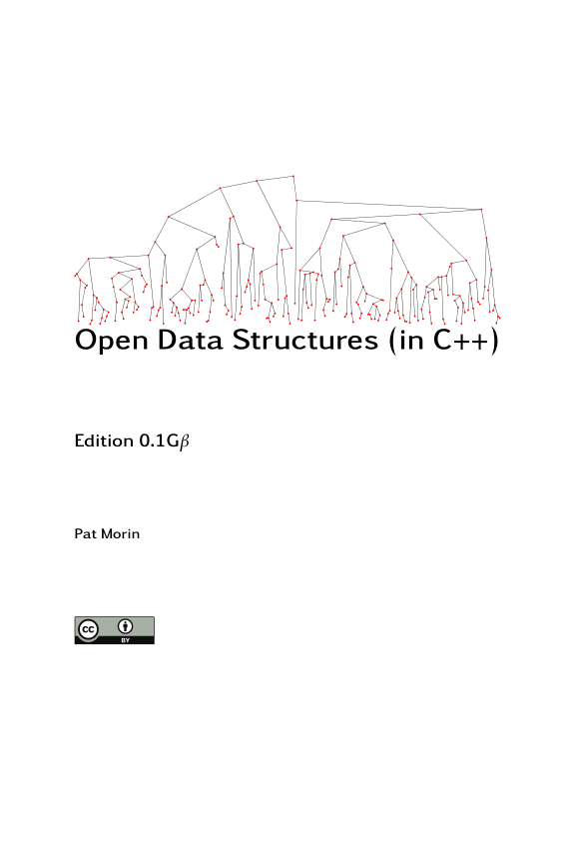
Reading
[CLRS] Ch10 (10.1-10.3)
[Morin] Ch1 (1.1, 1.2), Ch2 (2.1-2.4), Ch3 (3.1, 3.2)

Slide 23
Application of Stack: Balancing Symbols
Compiler needs to check whether the parentheses (), brackets [], and braces {} are matched.
CheckParen(str):
Stack s
int i=1
while (str[i]!=NULL)
if (str[i] is ‘(’ or ‘[’ or ‘{’)
s.push(str[i])
if (str[i] is ‘)’ or ‘]’ or ‘}’)
if (s.empty())
return false
if (s.pop() and str[i] mismatch)
return false
i++
return s.empty()
if (a>b) {b=c[10];}
if (a>b) {b=c[10];
if (a>b)) {b=c[10];}
if (a>b) {b=c[10);}

Slide 24




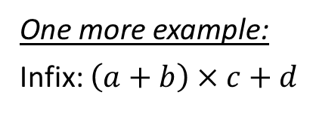


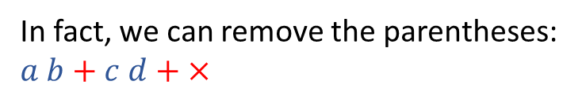

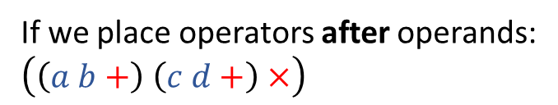


Application of Stack: Evaluating Postfix Expressions
How do we evaluate $\left(a+b\right)×(c+d)$?
$$×$$
infix expression
If we place operators after operands:
$\left(\left(a b+\right) \left(c d+\right)×\right)$
$$+$$
$$+$$
In fact, we can remove the parentheses:
$a b+c d+ ×$
$$a$$
$$b$$
$$c$$
$$d$$
postfix expression
Postfix notation, also known as reverse Polish notation (RPN), is a mathematical notation in which operators follow their operands. If there are multiple operations, operators are given immediately after their last operands.
RPN does not need parentheses!
One more example:
Infix: $\left(a+b\right)×c+d$
RPN: $a b+c×d+$

Slide 25

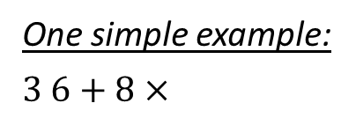

Application of Stack: Evaluating Postfix Expressions
Given an expression in RPN, how to evaluate its value?
EvalRPN(str):
Stack s
while ((token=NextToken(str))!=NULL)
if (token is an operand)
s.push(token)
else
res=PopOperandAndCalc(s,token)
s.push(res)
return s.pop()
Given an infix expression, how to convert it to RPN and evaluate its value?
(Beware of priorities!)
One simple example:
$3 6+8×$
6
8
$$+$$
$$×$$
3
9
72
6
8
3
3
9
9
72

Slide 26
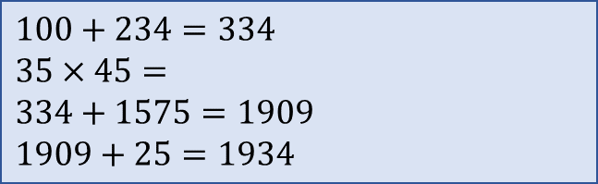
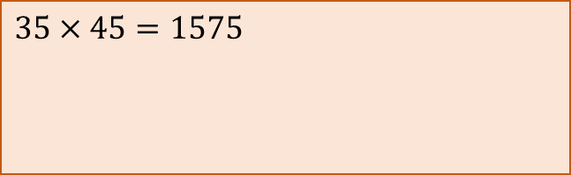


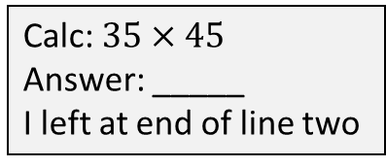

Application of Stack: Function Calls
How does a function call work?
Alice: only knows addition.
Bob: only knows multiplication.
Question: $100+234+35×45+25$
Calc: $35×45$
Answer: _____
I left at end of line two
$$1575$$
$100+234=334$
$35×45=$
$334+1575=1909$
$1909+25=1934$
$$1575$$
$35×45=1575$

Slide 27
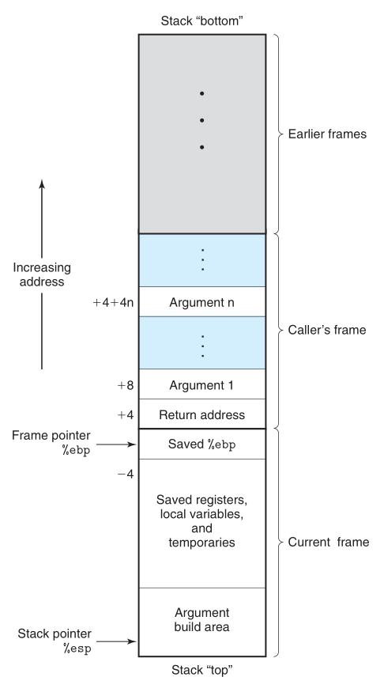
Application of Stack: Function Calls
Call Stack
How does a function call work?
EAX:1575
Alice: only knows addition.
Bob: only knows multiplication.
sum:
334
temp:
Question: $100+234+35×45+25$
1575
b:45
FuncAlice():
sum=100+234
temp=FuncBob(35,45)
sum+=temp
sum+=25
return sum
FuncBob(a,b):
c=a*b
return c
a:35
return addr
c:
1575

Slide 28
Eliminating Recursion
function calls are implemented via a “call stack”
with the help of a stack, recursion can be replaced by iteration
recursion is a specific type of function call
FactRec(val):
if (val == 1)
acc = 1
else
acc = FactRec(val-1)
res = val*acc
return res
FactIter(n):
Stack s
s.push(Frame(n,-1,NULL))
while (!s.empty())
frame=s.peek()
if (frame.val<=1)
frame.acc=1
if (frame.acc!=-1) {
res=(frame.val)*(frame.acc)
if (frame.prevFrame!=NULL) {
(frame.prevFrame)->acc=res }
s.pop() }
else
s.push(Frame(frame.val-1,-1,&frame))
return res
struct Frame {
int val
int acc
Frame* prevFrame
}

Slide 29
Eliminating Recursion
function calls are implemented via a “call stack”
with the help of a stack, recursion can be replaced by iteration
recursion is a specific type of function call
Q: Why recursion can be undesirable?
A: Recursion can be slow and memory consuming due to the creation and maintenance of stack frames.
Q: Why recursion can be desirable?
A: Recursion can make the code clearer, concise, and intuitive.

Slide 30
Tail Recursion
A function is called tail-recursive if each activation of the function will make at most one single recursive call, and will return immediately after that call.
X
√
FactRec(n):
if (n==1)
return 1
else
return n*FactRec(n-1)
EuclidGCDRec(m, n):
if (n==0)
return m
else
rem=m%n
return EuclidGCDRec(n, rem)

Slide 31
Tail Recursion
A function is called tail-recursive if each activation of the function will make at most a single recursive call, and will return immediately after that call.
Euclid (m, n):
if (n==0)
return m
else
rem=m%n
return Euclid(n, rem)
Euclid(6, 4):
4==0 ?
rem = 6%4
… … …
return 2
Euclid(4, 2):
2==0 ?
rem = 4%2
… … …
return 2
Once reaching the base case, can safely return result immediately!
Euclid(2, 0):
0==0 ?
return 2

Slide 32
Tail Recursion to Iteration
Each function parameter is a variable.
Convert the main body of the function into a loop:
Base cases: do computation and return results.
Recursive cases: do computation and update variables.
EuclidGCDRec (m, n):
if (n==0)
return m
else
rem=m%n
return EuclidGCDRec(n, rem)
EuclidGCDIter (m, n):
while (true)
if (n==0)
return m
else
rem=m%n
m=n
n=rem

Slide 33
Iteration versus Recursion
Recursion can be converted into iteration
Generic method: simulate a call stack
Special case: tail recursion
Iteration can be converted into tail recursion
No one is always perfect
Iteration can be faster and more memory efficient
Recursion can be clearer, more concise and intuitive

Slide 34
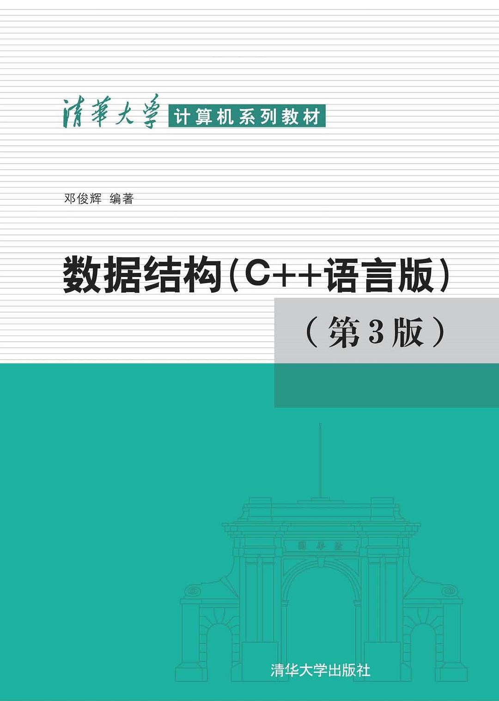
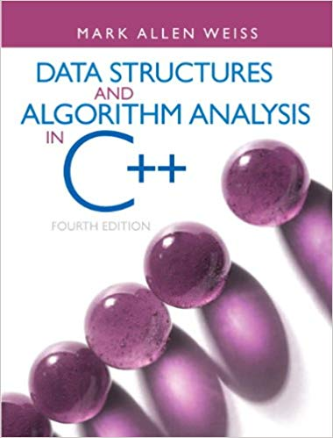
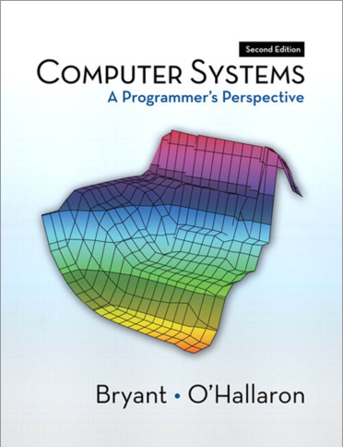
Reading
[Deng] Ch1 (1.4*), Ch4 (4.1-4.4)
[Weiss] Ch3 (3.6)
[CSAPP] Ch3 (3.7*)

